Slide 1
Development and Validation of the AAQ for Exercise (AAQ-Ex)
Sarah B. Staats, M.A. / Wichita State / ACBS WC 2014

Slide 2
Please stand and do 5-10 jumping jacks…
What if I asked you…
…if you are physically able to do so and your doctor would approve.

Slide 3
Exercise-related experiential avoidance
Even small doses of physical activity (PA) have powerful effects on short- and long-term physiological and psychological health and well-being.¹
Very few of us engage in recommended levels of PA. As low as 2.5% of men and 2.3% of women when measured objectively.²
One barrier to values-oriented exercise might be experiential avoidance (EA).³
Context-specific measures of EA (e.g., AIS in smoking⁴, CPAQ for chronic pain⁵, AADQ for diabetes self-care⁶) have consistently been better predictors of relevant behavior and/or stronger mediators of intervention outcomes than the more “global” AAQ-II⁷ or its predecessor.⁸
Notes:
Within specific health-related concerns and populations, researchers and clinicians have often developed “context-specific” versions of the AAQ-II in order to assess the avoidant behavior most relevant to their work. For example, Gifford, Antonuccio, Kohlenberg, Hayes, and Piasecki (2002) developed the Avoidance and Inflexibility Scale (AIS) to assess EA within the context of cigarette smoking. The AIS (α = .93) is composed of 13 items such as, “How likely is it that these thoughts will lead you to smoke?” and, “To what degree must you reduce the intensity of these bodily sensations in order not to smoke?” (Gifford et al., 2004). Another group of researchers has developed a measure of EA specifically related to chronic pain, the Chronic Pain Acceptance Questionnaire (McCracken, Vowles, & Eccleston, 2004). Its 20 items (α = .78) include statements like, “It’s OK to experience pain,” and, “Despite the pain, I am now sticking to a certain course in my life.” Most recently, Gregg, Callaghan, Hayes, and Glenn-Lawson (2007) developed the Acceptance and Action Diabetes Questionnaire (α = .94) to measure EA in the context of diabetes self-care. It is composed of 11 items such as, “I do not take care of my diabetes because it reminds me that I have diabetes,” and “I avoid thinking about what diabetes can do to me.”
Several studies have compared the performance of such context-specific measures of EA to that of the more global or general measure (Bond, Lloyd, & Guenole, 2013; Lillis & Hayes, 2008; Lillis, Hayes, Bunting, & Masuda, 2009; Luoma, Drake, Hayes, & Kohlenberg, 2011; MacKenzie & Kocovski, 2010; Sandoz, 2010; Westin, Hayes, & Andersson, 2008). In each of these cases, the context-specific measure was a better predictor of relevant behavior and/or a stronger mediator of intervention outcomes than was the AAQ-II or its predecessor. Other reviews have noted that both general and context-specific instruments appear to hold predictive power and treatment utility (McCracken & Keogh, 2009; McCracken, 2011), making both useful.

Slide 4
Roadmap
Briefly highlight some of the more interesting findings from series of seven studies conducted with AAQ-Ex
Discuss the final study in terms of its attempt to intervene
Discuss: How can this work inform large-scale change?

Slide 5
Study 1: Preliminary Psychometrics & Global EA
15 items emerged from pool of 55
Online survey of 47 undergraduates
Largely White (72%) and female (64%)
Mean age of 24 (SD = 6)
α = .85
Correlations (looking for “moderate”)
AAQ-II .33*
AAQ⁹ .22
Notes:
The assumption made in evaluating the preliminary concurrent validity of the AAQ-Ex was that its correlation with the more “general” or “global” AAQ-II (and, to a lesser degree, its parent AAQ) should be moderate (r = .40 - .60). Too low a correlation might indicate that the construct being measured is not related to EA at all, and, therefore, could not be regarded as a “context-specific measure of EA” (insufficient convergent validity). However, too high a correlation might indicate that the construct is not in any way distinct from global EA and, therefore, not a useful addition to existing assessments (insufficient divergent validity).

Slide 6
Study 2: Self-Reported PA/Fitness Level & Life Satisfaction
Online survey of 253 undergraduates
Largely White (75%) and female (74%)
Mean age of 22 (SD = 7)
α = .87
Minimum average partial (MAP) test¹⁰ yields 1 factor
Correlations
AAQ-II .27***
SWLS¹¹ -.28***
EDPW -.67***
Fitness -.67***
Notes:
…the purpose of the next study was to confirm its psychometric properties on a larger sample, replicate its relationship with the AAQ-II, and further evaluate its validity by examining its relationship with a self-report of personal fitness as well as life satisfaction.

Slide 7
AAQ-Ex correlations with EDPW and fitness level significantly greater than AAQ-II/SWLS
Hierarchical regressions confirmed that AAQ-Ex accounted for variance above and beyond age, gender, and global EA:
EDPW: R² change = .32, F(1, 71) = 41.56, p < .001
Fitness: R² change = .40, F(1, 71) = 53.84, p < .001
No other significant predictors

Slide 8
Study 3: Self-Reported PA/Fitness & “Neighbor” Instruments
Online survey of 322 undergraduates
Largely White (83%) and female (67%)
Mean age of 22 (SD = 7)
α = .87
Minimum average partial (MAP) test¹⁰ yields 1 factor
Correlations
AAQ-II .39***
BI-AAQ¹² .36***
DTS¹³ -.15**
Fitness -.51***
EDPW -.56***
EHPW -.31***
Notes:
Within DTS, AAQ-Ex more related to “Absorption” and “Appraisal” subscales than “Tolerance” and “Regulation.”
Fitness Level Discrepancy & EDPW Discrepancy also significantly correlated (.31*** and .43***). BUT: Although it was predicted that the AAQ-Ex would be more highly related to discrepancy measures than to fitness level or EDPW alone, the opposite was found. For example, the AAQ-Ex (15) was significantly more related to EDPW than EDPW discrepancy, z = 2.18, p = .03. The same questionnaire was also significantly more highly correlated with fitness level than with its corresponding discrepancy, z = 3.06, p < .01. These results suggest that the AAQ-Ex may be more associated with “not exercising” in general, as opposed to “not exercising in the presence of a strong desire to exercise.”

Slide 9
Hierarchical regressions confirmed that AAQ-Ex accounted for variance above and beyond age, gender, AAQ-II, BI-AAQ, DTS, and the degree to which participants valued health, fitness, exercise, and being active:
Fitness: R² change = .06, F(1, 309) = 27.47, p < .001
Age and BI-AAQ significant, smaller weights
EDPW: R² change = .14, F(1, 309) = 77.46, p < .001
BI-AAQ and DTS significant, smaller weights
EHPW: R² change = .04, F(1, 309) = 15.64, p < .001
No other significant predictors

Slide 10
ANOVA was significant, p < .001
Tukey’s HSD revealed (b) and (c) significantly more avoidant than (a) and (d)
Suggests potential to discriminate between EA vs. inability
But maybe not EA vs. disinterest/ devaluation

Slide 11
Those who were advised to exercise had higher AAQ-Ex scores overall
Within those, ANOVAs on behavioral response were significant; p < .001, p = .002
Those who scored lowest on AAQ-Ex were those that had increased PA and were keeping it up.

Slide 12
Some last remarks on Study 3
AAQ-Ex scores also reliably positively correlated with the number of self-described failed attempts (started but not completed/utilized) at…
Home fitness programs, .19***
Health club/gym memberships, .18***
Weight loss programs, .20***
Diets, .25***
Similar relationship with BMI (from self-reported height and weight)…
.19, p = .001

Slide 13
Study 4: University Fitness Class Outcomes
27 university faculty and staff members enrolled in 8-week fitness classes (yoga, water aerobics, and “boot camp”)
Largely White (93%) and female (93%)
Mean age of 49 (SD = 14)
α = .75
9-Week Test-Retest = .91***, n = 11
Correlations
BMI .45*
vs. .28 for AAQ-II
Blood pressure -.23
vs. .05 for AAQ-II
Heart rate .19
vs. .07 for AAQ-II
Class eval. -.55
vs. .73* for AAQ-II
Absences -.08
vs. .35 for AAQ-II

Slide 14
Study 5: Physically Exerting Tasks In-Lab
Analog study of 85 undergraduates completing counterbalanced wall sit and jumping jack tasks “as long as possible”
Verbally indicated when they began to feel (1) distress and (2) the urge to quit
Largely White (72%) and female (67%)
Mean age of 21 (SD = 6)
α = .87
Correlations
ASI¹⁴ .48***
Neuroticism (NEO-FFI)¹⁵ .39***
Replicated prior self-reported exercise frequency and fitness level findings
No sig. relationships with distress tolerance (“distress” to d/c), perseverance (“wanna quit” to d/c), or SUDS ratings for either wall sit or jumping jack
Distress tolerance trended (-.20)
Many participants cited lack of music (ecological validity) and reason/purpose (values/incentive) as reasons for discontinuation

Slide 15
Study 6: Test-Retest & Social Desirability
Paper-pencil survey of 153 undergraduates
Largely White (78%) and coed (51% male)
Mean age of 21 (SD = 5)
α = .86
3-Month Test-Retest = .90***, n = 84
Correlations
Edwards¹⁶ -.41***
Marlowe Crowne¹⁷ -.22**
Fisher’s r-to-z transformation z = 1.86, p = .06

Slide 16
Study 7: Clinical Intervention
Acceptance- and Mindfulness-Based Intervention to Promote Physical Activity
Formulated via literature review and integrating components from prior studies¹⁸, with some added and original elements
“Module” within Via Christi Weight Management’s HMR (Health Management Resources) program
Evidence-based
Focus on the “Triple Imperative”
Physical acivity
Vegetable and fruit consumption
Meal replacements

Slide 17
Study 7: What it looked like
Four weekly 50-60 minute group sessions
Week 1: Values & Committed Action
Attending Your Funeral; listing values and tying PA to them; distal→proximal timed goal-setting
Week 2: SAC, Mindfulness, & Defusion
Observer You; Shark Tank metaphor; Leaves on a Stream; Walking Through Thoughts
Week 3: Acceptance & Willingness
Wear Your Pain; ubiquity of human suffering and mind as problem-solver; Unwelcome Party Guest; Serenity Prayer; Thank Your Mind
Week 4: Review of Concepts
Guided mindfulness meditation; “Given a distinction between…” hexagon question; “I Can Move” song; clarifying Q&A

Slide 18
Study 7: Preliminary Findings
Measures: weekly PA (in calories), weight change, AAQ-Ex, AAQ-II
Sample: 45 clinical participants across 3 cohorts
35 females (78%) and 10 males
38 identified as White (84%) and the remaining as Other or not listed
Ages 34 – 73 (M = 57, SD = 9)
Dose:
10 people attended one session
7 people attended two sessions
12 people attended three sessions
16 people attended all four sessions
Process measures completed 71% of the time (89 of 124)
α = .82 (W1), .75 (W2), .85 (W3), .79 (W4)

Slide 19
Physical Activity
Average weekly PA calories
Pre-Intervention = 2140 (SD = 1041)
During Intervention = 1848 (SD = 921)
Post-Intervention = 1728 (SD = 899)
No significant differences, p = .15

Slide 20
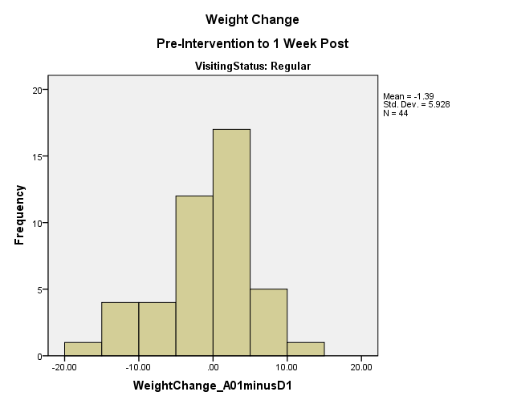
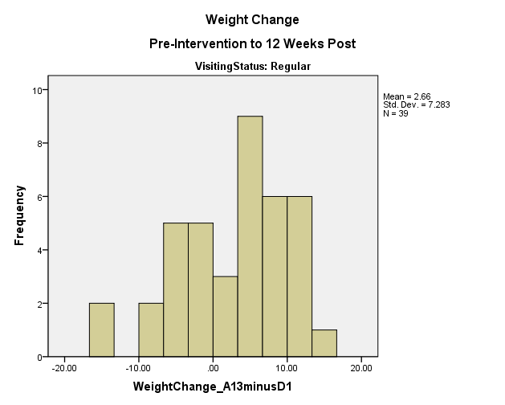
Weight

Slide 21
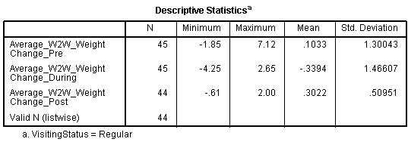
Week-to-week fluctuations
During the 5 weeks prior to my showing up, patients tended to stay about the same from week to week
During the 4 intervention weeks, they tended to lose about a third of a pound each week.
During the 12 weeks after intervention, they gained that third of a pound back.

Slide 22
Acceptance-related measures
AAQ-Ex may be more closely related to PA (self-reported calories) and weight changes (pre- to post- and follow-up; and week-to week fluctuations)
Strength of any moderating and mediating effects still unknown
Lots to look at

Slide 23
Study 7: Limitations & Next Steps
Emphasis on weight
Much missing data (process and outcome measures)
Reliance on self-report (accelerometers, Fitbit?)
Seasonal confound (Aug→Dec; Oct→Jan)
Holidays (may have affected eating and PA)
Colder weather (may have affected eating and PA)
BUT: Non-ACT TAU comparison groups may become available for analysis
More fine-grained and idiographic analyses of process and outcomes across multiple (21) time points needed
Large-scale translation
In existing programs (instructor buy-in critical)
In primary care (component vs. whole-model?)

Slide 24
Study | N | α | Test-Retest | Corr. with AAQ-II
1 | 47 | .85 |  | .33*
2 | 253 | .87 |  | .27***
3 | 322 | .87 |  | .39***
4 | 27 | .75 | .91*** 9 weeks; n = 11 | .23
5 | 85 | .87 |  | .36***
6 | 153 | .86 | .90*** 3 months; n = 84
7 | W1: 26 W2: 24 W3: 20 W4: 19 | .82 .75 .85 .79 | .93*** 4 weeks; n = 13 | .37 .49* .66** .48”
* p < .05, ** p < .01, *** p < .001

Slide 25
References
¹Katzmarzyk & Janssen, 2004; Brown, Heath, & Levin Martin, 2010; Little, Safdar, Wilkin, Tarnopolsky, & Gibala, 2010
²Roger et al., 2011; Prince et al., 2008; Troiano et al., 2008
³Hayes, Strosahl, & Wilson, 2012
⁴Gifford, Antonuccio, Kohlenberg, Hayes, & Piasecki, 2002
⁵McCracken, Vowles, & Eccleston, 2004
⁶Gregg, Callaghan, Hayes, & Glenn-Lawson, 2007
⁷Bond et al., 2011
⁸Bond, Lloyd, & Guenole, 2013; Lillis & Hayes, 2008; Lillis, Hayes, Bunting, & Masuda, 2009; Luoma, Drake, Hayes, & Kohlenberg, 2011; MacKenzie & Kocovski, 2010; Sandoz, 2010; Westin, Hayes, & Andersson, 2008
⁹Hayes et al., 2004
¹⁰Velicer, 1976
¹¹Diener, Emmons, Larsen, & Griffin, 1985
¹²Sandoz, 2010
¹³Simons & Gaher, 2005
¹⁴Reiss, Peterson, Gursky, & McNally, 1986
¹⁵Costa & McCrae, 1992
¹⁶Edwards, 1957
¹⁷Crowne & Marlow, 1960
¹⁸Forman, Butryn, Hoffman, & Herbert, 2009; Lillis, Hayes, Bunting, & Masuda, 2009; Tapper, Shaw, Ilsley, Hill, Bond, & Moore, 2009; Butryn, Forman, Hoffman, Shaw, & Juarascio, 2011; Goodwin, Forman, Herbert, Butryn, & Ledley, 2011; Niemeier, Leahey, Palm Reed, Brown, & Wing, 2012

Slide 26
Thank you so much!
sarahbethstaats@gmail.com
Campus Box 4, 1845 Fairmount, Wichita, Kansas 67260

